Slide 1
Final Progress Report

Slide 2
Project Management

Slide 3
Lillian Greenberg
Frequent Communications with Customer
Emailed back and forth often as the project moves forward with questions and updates
Communicated with team leads to evaluate and plan from responses
Scheduling Meetings
Sept 18, 27, Oct 16, Dec 6, took notes on questions to discuss with team leads
Creation of Presentations
Developed the Slides documents and polished them up
Lead presentations and introduced team members
Kept team members up to date on due dates and presentations with both Simon and Parisa
Consolidation of bi-weekly reports
Collected all reports from team leaders and created a summarized version to pass on to Simon
Discussion with Team Leads
Multiple impromptu meetings with the leads of both teams to determine goals and clarify requirements

Slide 4
R&D + SysOps

Slide 5
Shameer Rao (1/2)
Tasks Accomplished
Account Management - Admin, Organization, & Basic User
Google Map Widget
Tag Filtering System
Site Tutorial
Creating Posts
Next Steps
Displaying video/audio upload for posts
Update gMap Widget Markers
Improve site quality & aesthetics

Slide 6
Shameer Rao (2/2)
Established Connection to an Azure SQL Database
Structured Database Schema
Primary Keys, Foreign Keys, and Relations
Tables, Queries, & Views
Automatically Backed Up
MS SQL Defender
Configured Azure Platform Settings for Security, Storage, & Performance
Updated Server Firewall Rules
Storage: 32 GB, Compute: <10%, $4.5/$200 Monthly Credit

Slide 7
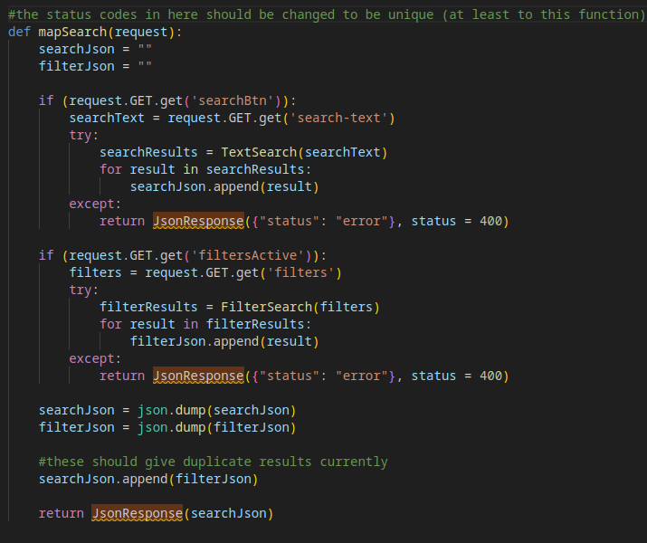
Jordan Golden
Search request program flow

Slide 8
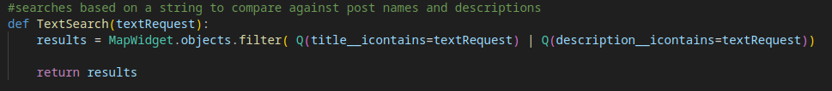
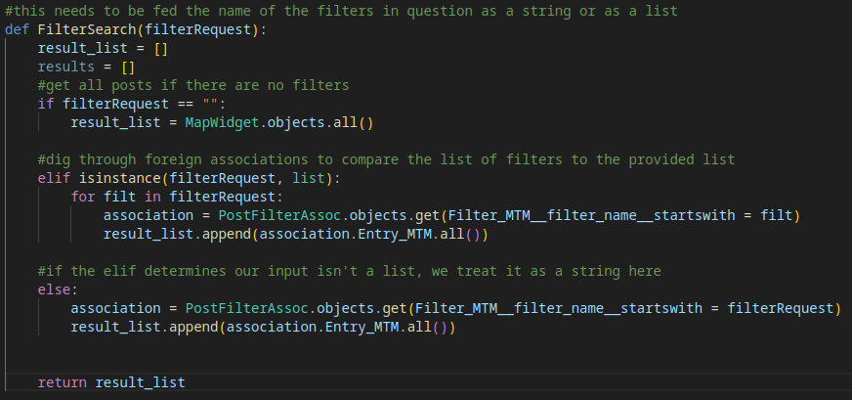
Jordan Golden

Slide 9
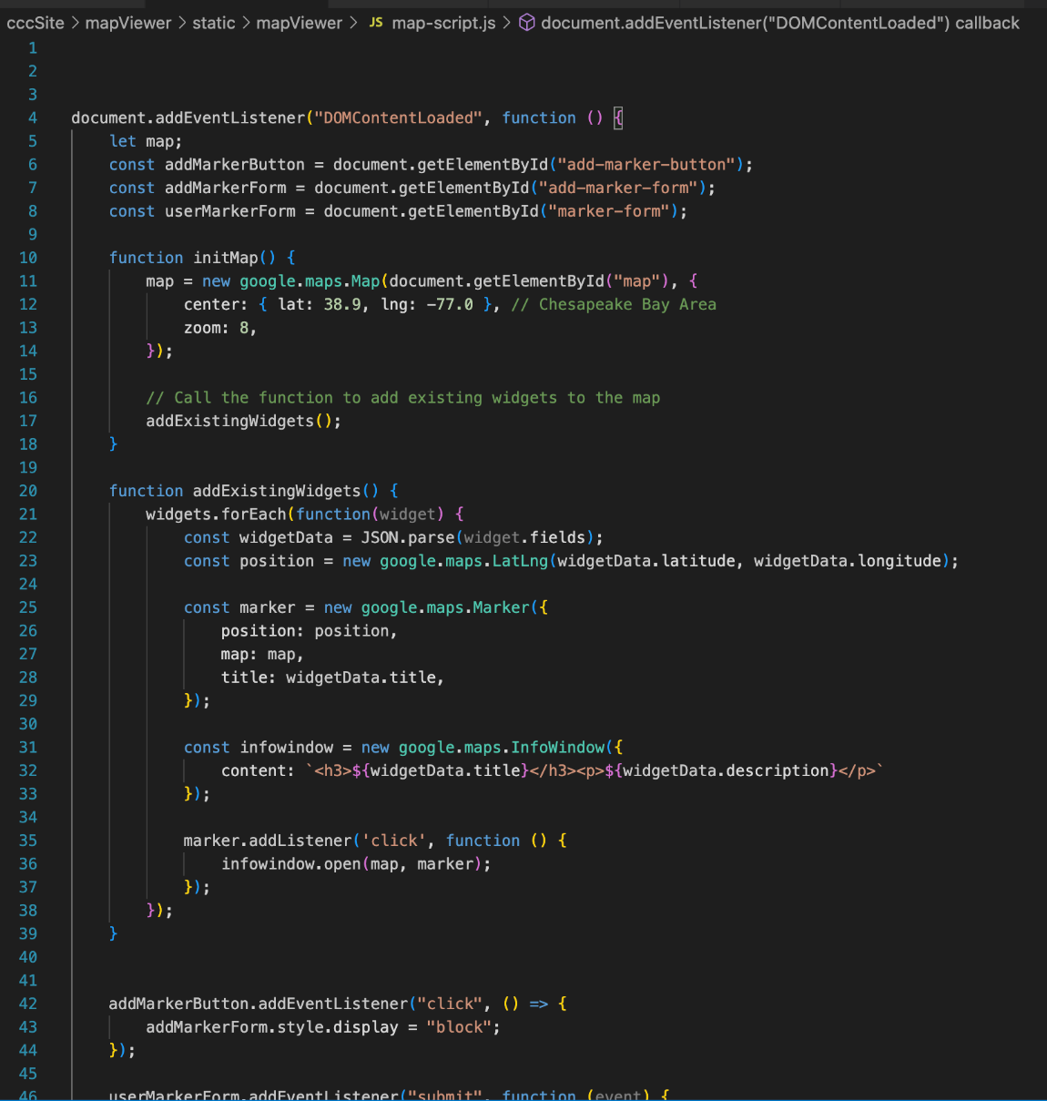
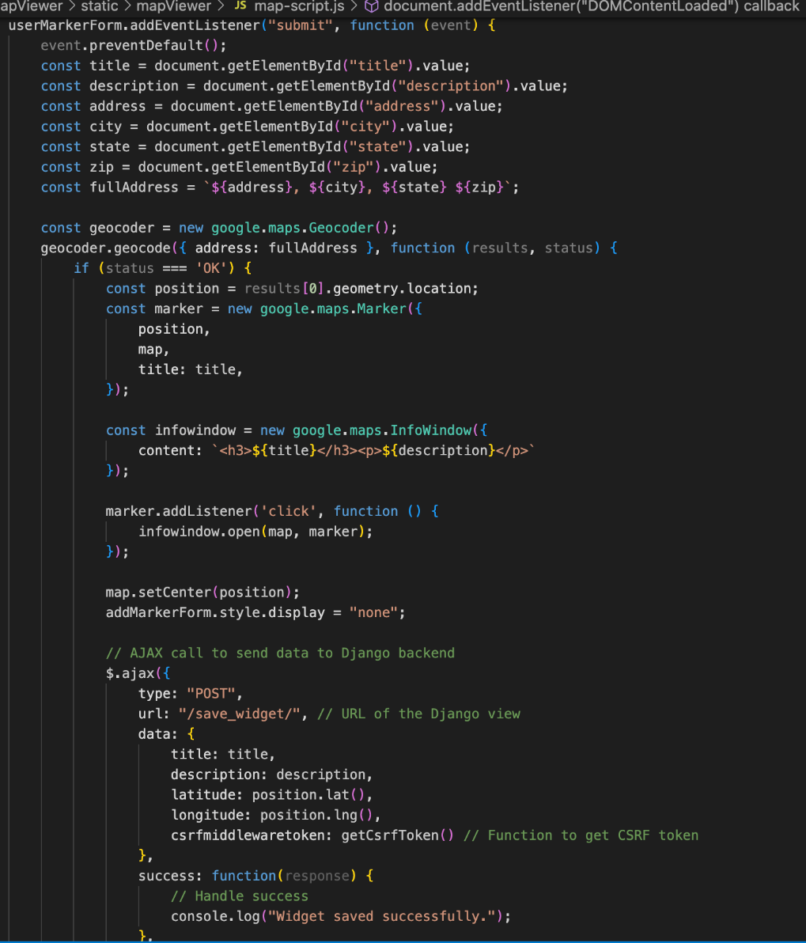
Alexander Stoyanov-Roberts
HTML
Completed HTML for each page on the site
Implemented the navbar and broke pages into individual HTML code
JavaScript
Completed all JavaScript for each site page.
Each page has custom JS that can be edited for just that page
Made the map instance and the create a post submission JS.
Working on AJAX partnered with JS to send cookies back and forth to preload the map
API and Styles
Integrated my googlemaps API key with the website to get the google maps working
Created the Styles.css folder, and made all of the initial design decisions and css changes.

Slide 10
Matthew Grimelli
Improved Website UI
Sitewide
Removed color transition on page headers
Adjusted pages to more closely match SDD
Changed default font to match SMCM style guide
Adjusted colors to match SMCM style guide
Removed redundant page headers
My Account
Centered and resized profile picture
Added “Edit profile” button (previously was a link)
Sign in
Added two column layout
Improved Google sign in button
Added “What it means to be a contributor” section
Map
Added two column layout
Navigation bar
Left justified header content
Added SMCM logo (stand in for customer approved logo)
Improved header highlight functionality
Current page now permanently highlighted
Improved scrolling behavior
Nav bar now scrolls off screen instead of following user
Footer
Added improved SMCM logo

Slide 11
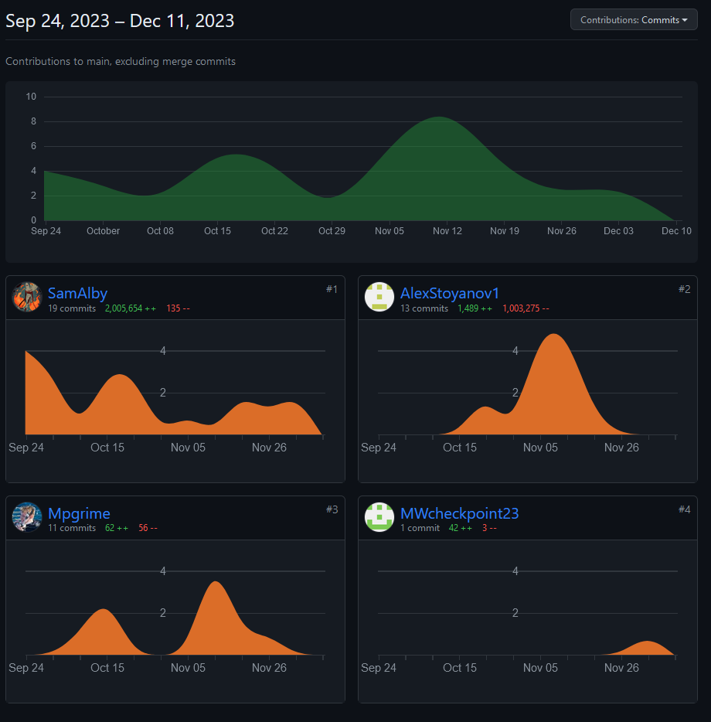
Samuel Albanese
Source Control
Github
Created and maintained repository for the website, keeping everyone on the same page codewise
Microsoft Azure
Hooked together Github and Azure with automatic workflows that deploys the site any time there is a push, keeping the website up to date automatically
Improved Website UI
Contact page
Revamped the contact page into a help/FAQ page based on SDD designs
Google Maps
API
Researched and discovered Google Maps solution upon inception of the project
Created first prototype of the maps API
Team Collaboration
Worked closely with team lead Shameer and fellow dev Matthew on getting the Google Maps API to work for our purposes, resounding success in my eyes
* lines of code not indicative of contribution

Slide 12
Marjon Ward
Assisted with site visuals
Initial designer of the homepage before site overhaul
Worked with Isabella from QA for guidelines on the visual design of web pages
Sketches and drafts were discussed early on, eventually drawn out by Isabella
Assisting and double-checking the design changes made in HTML and CSS
On-brand colors and footer logo
Ongoing addition of information in “About” page, mainly formatting to the SDD
Logo Design
Created the “Chesapeake Wave”, the main logo for Chesapeake Community Connect
Made logo drafts and sent them to the customer via Lillian or Kylie
Misc.
Temporarily helped with research of the Google API
Made the R&D To-Do List to organize tasks early into the project

Slide 13
Ariat Ojulu
Progress Report:
Color Scheme Enhancement:
Implemented a simple and positive color scheme.
Exploring softer, complementary colors for a harmonious visual environment.
Font Selection for Readability:
Selected a clean and easy-to-read font to enhance text legibility across the homepage.
Video Content Creation:
Overview: Create a video highlighting the main sections available on the homepage.
Navigation: Demonstrate user navigation through different sections and access points.
Key Features Showcase: Highlight the tag filtering system, submission process, and map pins system for a comprehensive view.

Slide 14
Dexter Mueller
Accounts, Authentication, and Authorization
Implemented sign in with Google for account authentication, capturing user information in a Django model
Used Django's session middleware to track the signed in user and their ranking through their use of the site, allowing pages to dynamically fetch information about the user, as well as allow actions based on account permission level
Created django views allowing the user to upload a profile picture and edit their information, as well as sign in or sign out depending on whether they have already signed in or not
Set the url conf to only allow access to pages in a way that makes sense (e.g. trying to access account management will redirect to sign in if user hasn't signed in)
Converted the existing HTML and JS site to Django over Thanksgiving break, allowing integration of everyone's component parts
Translated all the HTML to Django template markup, split the HTML into separate templates to take advantage of template inheritance
Rewrote the contact form functionality from JS to Django (python?), allowing us to capture messages in a model
Did my best at leading the site demo during the final client presentation

Slide 15
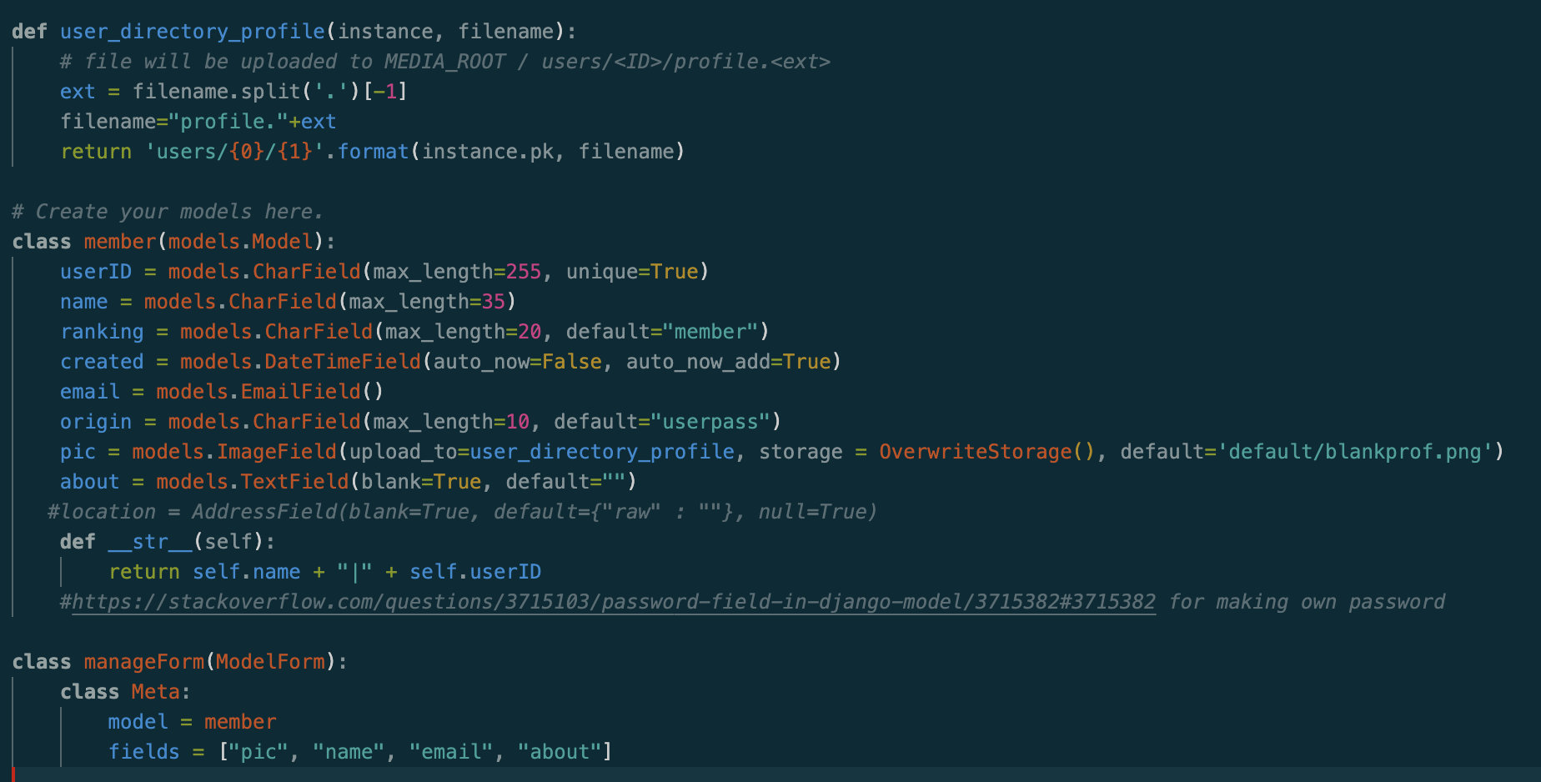
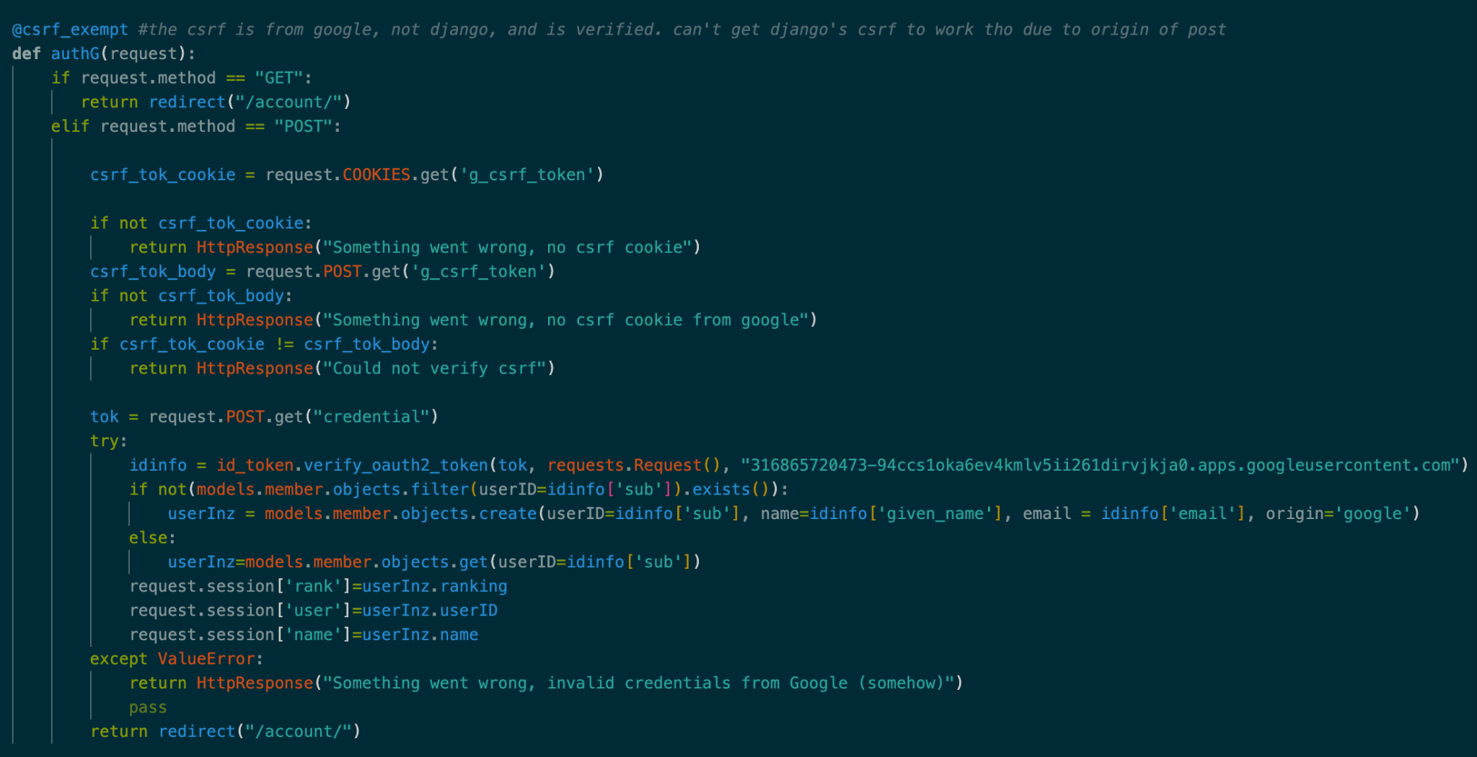
Authentication

Slide 16
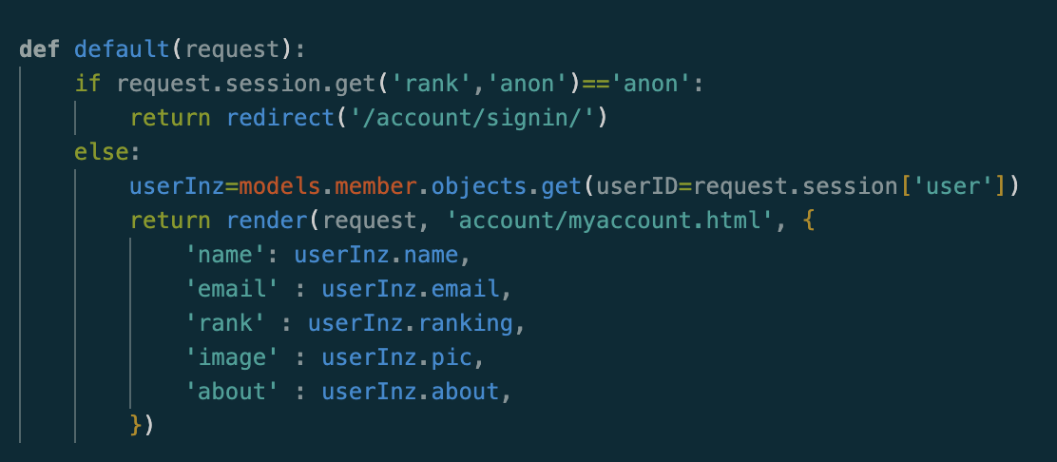
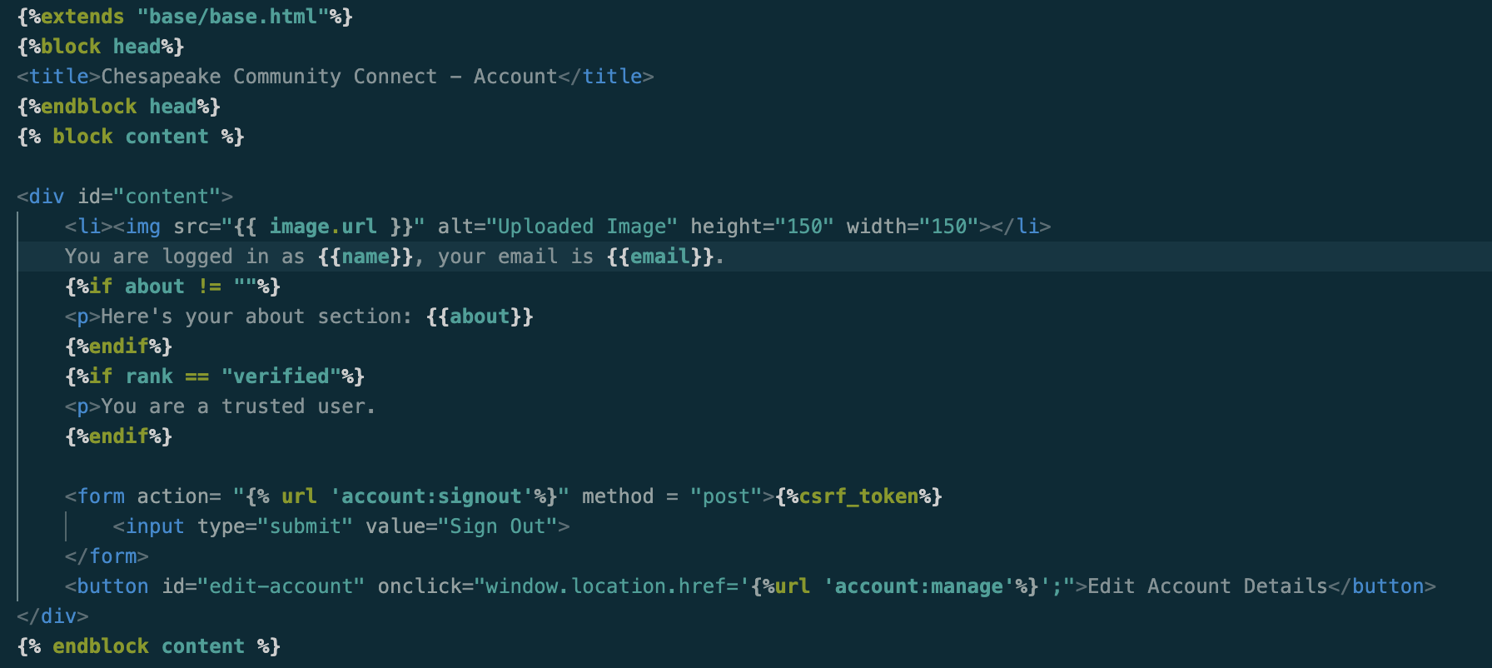
Authorization Example

Slide 17
Garrett Bridgwater
Development Server
Microsoft Azure
Year round free service for students
$200/month educational credit
All set up for next semester

Slide 18
Quality Assurance

Slide 19
Kylie Hall
Completed:
SDP
SRS
SDD
STP
Important Information Document for next semester that explains yellow flags going forward. https://docs.google.com/document/d/1Vn5V0Fq-71c7Yagx9_Y-ucf8QgrQcAW8__ir9I7CGZg/edit?usp=sharing
Next Semester:
Traceability Matrix
User Manual
Testing
Continuing Development closely following SDD and requirements set within living documents

Slide 20
Naheed John
This semester has been fulfilling, and I enjoyed working and collaborating with my team.
I assisted with working on the TestBrit excel spreadsheet to better understand how we would implement the SRS information into a testing excel spreadsheet
I worked on the the STP excel spreadsheet, by using the SRS information to help track the data of the testing results in an efficient manner. I worked on sections 2.1.2 (Contributor Page Display) and 2.1.3 (Help/Tutorial Page)
I edited the 2.1.2 (Contributor Page Display) and 2.1.3 (Help/Tutorial Page) in the SRS document
I added edits to the Admin approval process, User Accessibility, User Submissions and the Website Delivery on the SRS document
Many times I chipped in wherever Kylie needed me, our goal was to accomplish and assist others who may need help accomplishing there tasks

Slide 21
Malik Hill
Assisted in completing the SRS document by finishing sections 2.1 (Website Display) on the document.
Added the “shall” statements
Created a functionality section under 2.2 that aligns with 2.1.6 which covers the “contact us” page
Completed sections 5 and 7
Researched ways to display test case percentages on excel
Added the Procedural Design flowchart in the SDD document
Which includes Homepage, About page Contributor, login/account management, Uploads, map, search filter, and help & Tutorial.
https://drive.google.com/file/d/1FYa9xsnCEwrHt9GMO8cjTtgMqB1R-sG1/view?usp=drive_link

Slide 22
John Heinig
Software Development Plan (SDP)
Subsections 4.1 (project estimates), 4.2(project plan).,4.3.2(quality control)
2. Software Requirements Specification (SRS)
Laid out many of the requirements under section 2.2 for website functionalities
3. Software Design Document (SDD)
Created outlines for the content upload page as well as the about page
4. Software Test Plan (STP)
Created various test cases for 2.2.1.3 which outlines the tests for content upload

Slide 23
Isabella Stephens
Software Development Plan [SDP]
Organizational Structure (3.1)
Roles & Responsibilities (3.3)
Software Requirement Specification [SRS]
Uncategorized UI Requirements
Formatting
Misc. elaboration and rewording
Software Test Plan [STP]
Reworded/elaborated various tests
Software Design Document [SDD]
Formatting
Purpose (1.1)
Program Structure Diagram (3.1)
Home Screen Display (4.3.1)
Contributor Page Display (4.3.2 )
Login Display (4.3.3)
Sign Up Display (4.3.4)
Profile Management Display (4.3.6)
Help & Tutorial Page Display (4.3.8)
Admin Page Display (4.3.9)

Slide 24
Brittany Brenneman
(1) Software Development Plan
Additions
Section 2.2 Assumptions and Constraints
Section 4.2.2 Iteration Objectives
(2) Software Requirements Specifications
Additions
Section 1 Introduction
Section 3 System Requirements
3.1 Hardware
3.2 Software
Organization
Section 2 Functional Description
Website Display
Website Functionality
(3) Software Test Plan
Test Procedures (16 Total)
2.1.1 Homepage (8)
2.2.4 Administrator Features (6)
Website Menu Taskbar (1)
Project Display (1)

Slide 25
Yaro Kulchyckyj
Software Development Plan [SDP]
2.1 Project Purpose, Scope, and Objectives
3.2 External Interfaces
4.2.4 Project Schedule Gantt Chart
4.3.4 Risk Management
Software Requirement Specification [SRS]
Assisted in developing the requirements for transitioning the project from a more social oriented website to a more database oriented website.
Software Design Description [SDD]
Helped map out the website structure
Created some initial UI sketches which team members then used to further finalize the UI
Software Test Plan [STP]
Section 5 - Reporting and Corrective Actions
Section 7 - Test Procedures
Created the excel document to track testing
Added conditional formatting to better visualize which tests have passed/failed testing

